Slide 1
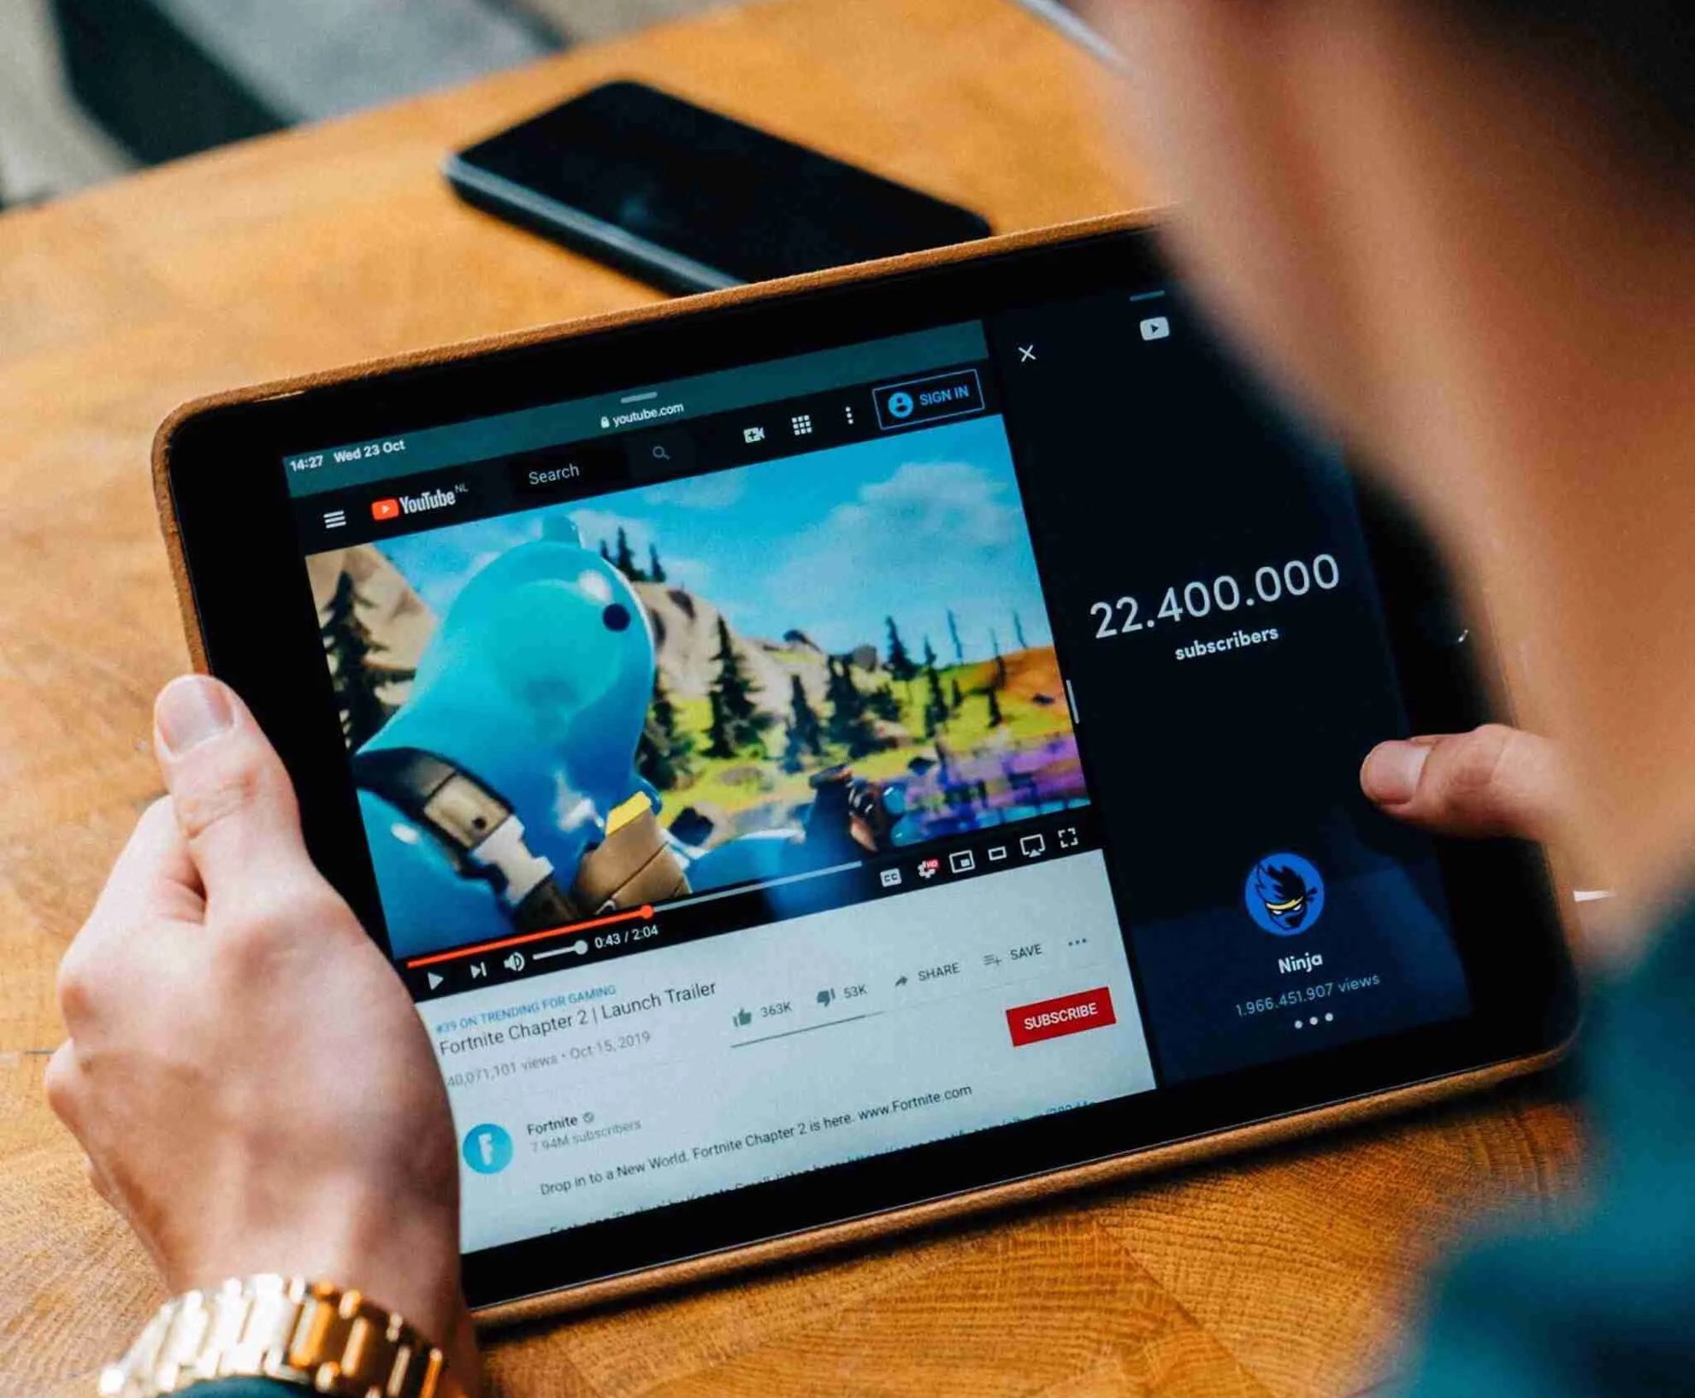

YouTube Trend Analysis
Group 2

Slide 2
Exploratory Research Background
Background:
Our project aims to analyse various datasets from YouTube and identify observable trends. The datasets analysed include the Top US Trending Videos from Kaggle for August to November of 2020, as well as three datasets obtained from the YouTube API: YouTube Search Items, YouTube Video Statistics, and YouTube Channel Statistics. The project encompasses trend analysis of user behaviours, video statistics, channel statistics, and category statistics, spanning the years 2019 and 2020. In particular, the review provides valuable insights into viewer trends during the strict COVID-19 lockdown in the US from March to June of 2020.
Research Questions to Answer:
Find out whether YouTube trends reflect societal events, such as quarantine challenges, vlogs, new music video releases, and video games?
b. As viewership of a video increases, it is typical to observe a corresponding rise in the number of likes, dislikes, and comments left by viewers. In essence, there tends to be a direct relationship between the level of viewer reactions and the size of the audience for a given video.
c. In light of the COVID-19 pandemic, it is apparent that there have been significant changes in YouTube viewer habits during 2020 when compared to 2019?
Data Source:
The dataset used in this project comprises various sources, including the Top US Trending Videos on Kaggle spanning August to November 2020, as well as three datasets obtained from the YouTube API. These sources include YouTube Search Items, YouTube Video Statistics, and YouTube Channel Statistics.
Table of Content:
Top Five Liked Videos from August to November 2020
Most Published Videos per Category from August to November 2020
Top Trending Channels from August to October 2020
Relationship between View Count and Reactions per Category
Comparison Between the Top Two Categories: Music vs. Entertainment
Most Watched Videos in 2019
Most Watched Videos in 2020
The Most Viewed Quarantine Challenge Videos During Strict COVID Lockdown Findings and Observations Post - Mortem

Slide 3
Data Cleaning & Exploration

Slide 4
Data Source
This project used a Kaggle CSV file and YouTube API to create the datasets regarding trends overtime based on the number of views. The CSV file solely focuses on US Trending data whereas the YouTube API expanded internationally. The data collected was transformed in order to analyze and visualize with Python; it included the following factors:
Video Title
Channel Title
Publish Time
Tags
Views
Likes and Dislikes
Description
Comment Count The following three datasets were pulled from the YouTube API: YouTube Search Items, YouTube Video Statistics, and Youtube Channel Statistics. All three datasets are linked by the unique Video ID and Channel ID fields.

Slide 5
Data Cleaning and Exploration
Pandas Process With Pandas, we read the CSV file and parsed the YouTube date format into a datetime format. We calculated the lag time for each video to trend and replaced the category ID numbers with category names for readability. Afterwards, we sorted the dataframe by the number of likes and dropped any duplicate columns. We also used the groupby function in various cells for the date, number of published trending videos, categories, and months.
Matplotlib Process Using the previously created PANDAS dataframe we created additional layers to parse specific data per month, this included trending categories and user statistics. We also added supplemental grouby functions to organize this data. Once the data was organized, we were able to create bar and scatter graphs using pyplot. The heatmap was created with a correlation function and seaborn.
API Process The dataset includes data gathered from videos on YouTube API that contained highest viewcounts in specific time periods. There are three kinds of data files, the first one includes youtube search items with snippet descriptions, the second includes youtube video statistics, and the third includes youtube channel statistic. They are all linked by the unique video_id and channel_id field. Once we pulled the necessary data, we dropped the duplicate or irrelevant columns and reorganized the created dataframes for readability. We also merged data frames based on the video ID and channel ID fields. This dataset was sorted based on view count, number of likes and dislikes. One issue that arose while exploring the data is that we had to repeatedly call the API without going over the quota. There are only so many requests we could do and we had to implement another method that allowed us to continue our analysis without overextending our API limit.
Insights we had while exploring data that we didn’t anticipate:
We were surprised that trending videos overwhelmingly are ‘liked’ by users. With the exception of the ‘News and Politics’ category, in which ~15% of trending videos were disliked, all of the other categories had ‘likes’ > 97%. This seems to belie the old adage that ‘there is no bad publicity.’ It appears that ‘liked’ videos are the ones that trend, and that attempting to get views or publicity by attracting haters is a bad strategy.
Music videos are the most likely to trend by far. This is unexpected, as a ‘video’’ is not needed to enjoy music, and as there are many competing music streaming services (Spotify, Apple). It turns out that ‘more music is played on youtube than on spotify, apple music and every other audio streaming platform combined.’ Youtube attracted 46% of all music streaming listening time, followed by 23% for paid audio platforms and 22% for free audio platforms. (Source: IFPI Global Music Report)
It only takes, on average, 7 days for a video to trend, and if your video doesn’t trend within 10 days, it is unlikely to trend. This makes youtube very different from other media platforms, such as TV, where it takes between 1-3 seasons for a show to become a hit, or radio, where is typically takes 8-12 weeks for a song to reach the Top 40 after release.
Discuss any problems that arose after exploring the data, and how you resolved them.
Youtube timestamps its videos in a non-standard format. We had to text parse the date format and convert the dates and times to the Python datetime format. We wrote a function to do this.
Youtube uses integers instead of strings for its video categories. We had to download a category dictionary (which can change with time), and convert the category numbers to category names using the ‘replace’ function.
Channel owners will often publish multiple copies of the same video using the same title, on different dates. These videos post as ‘unique’ videos with unique statistics. Ideally we would roll up statistics for duplicate videos into a single data point for our analysis. However, when we actually viewed videos with the same title from the same channel, we found that some videos would have subtle differences (for example, one video may have text pop-ups, and another not). We couldn’t figure out, short of watching ‘duplicate’ video with human eyes, if the videos were actually different and therefore shouldn’t be rolled up. So instead, we kept the ‘most popular’ instance of the duplicately-titled videos. Interestingly, the 2nd most popular instance of duplicately-titled videos typically had views that were orders of magnitude lower than the most popular video. So we feel our analysis still allows for significant inferences about the videos.

Slide 6
Findings

Slide 7
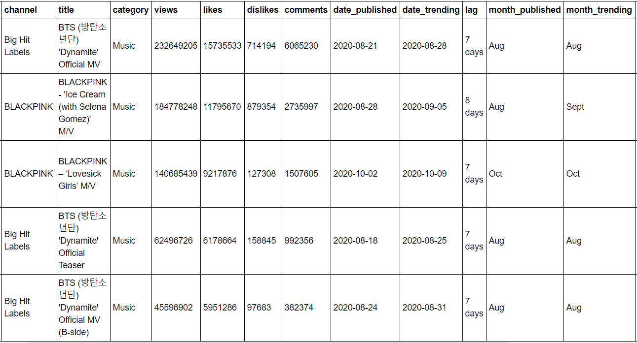
Top 5 Liked Videos From Aug to Nov 2020 The top five liked videos during this timeframe all fall in the music category; K-Pop groups seem to dominate this category.

Slide 8
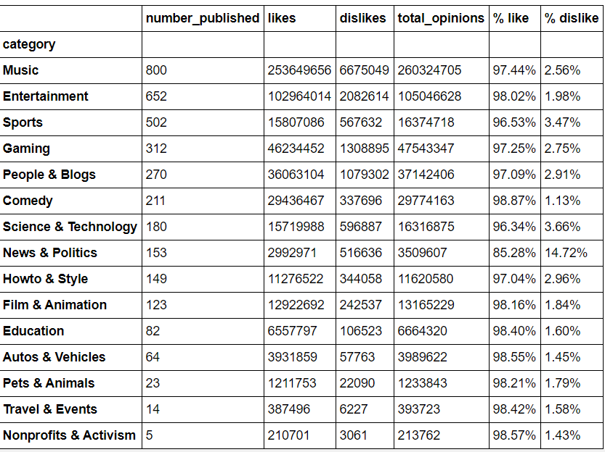
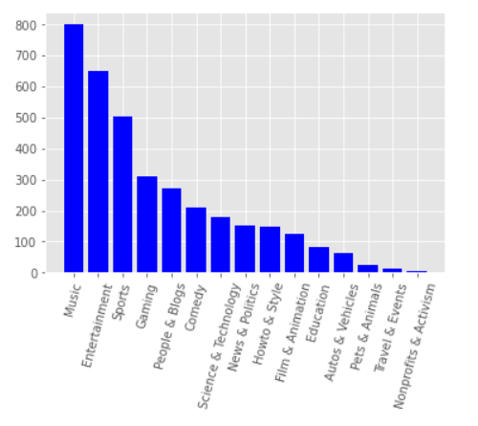
Most Published Videos per Category from August to November 2020 Music and entertainment publish the highest number of videos; surprisingly, Nonprofits and Activism had the least number of published videos with only five videos.

Slide 9
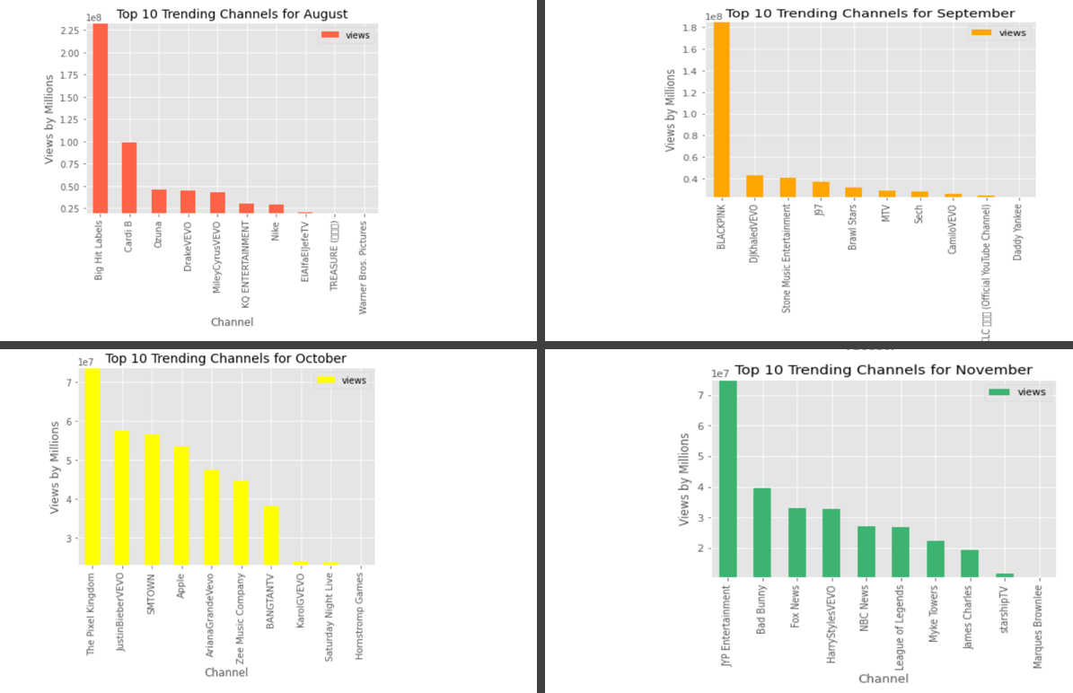
Top Trending Channels from August to October 2020 According to the top trending channel bar charts, the most popular channels in each month fall into either the music or entertainment categories. October is the exception as a gaming channel was the most popular as it reviewed the game Among Us.

Slide 10
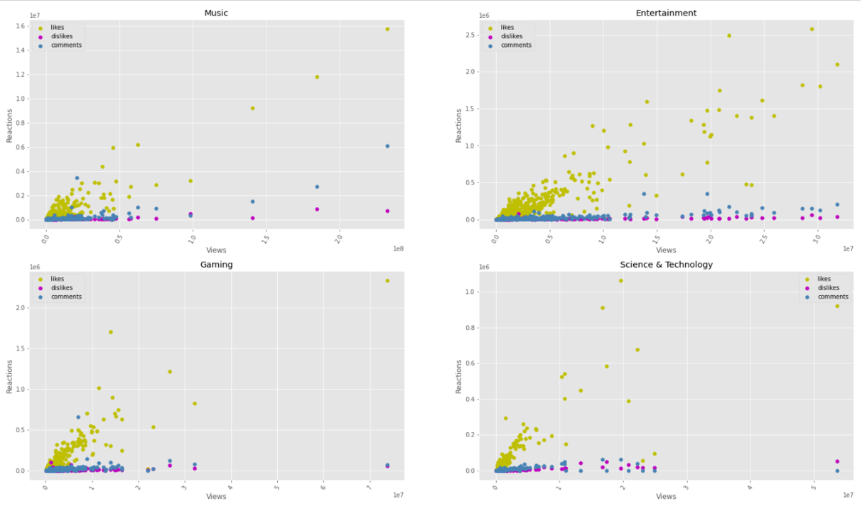
Relationship between View Count and Reactions per Category

Slide 11
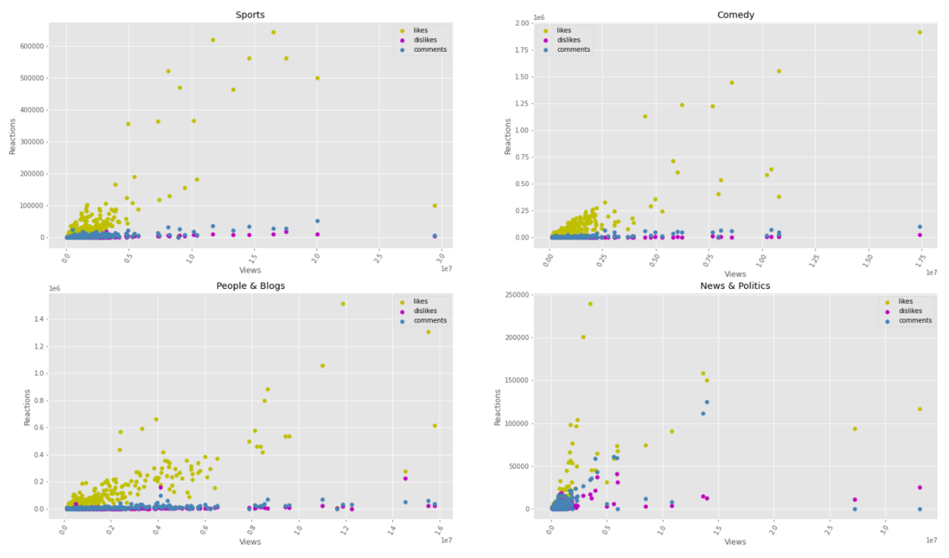
These scatter plots display the relationship between view count and reactions per category. Reactions consist of the number of likes, number of dislikes, and number of comments.

Slide 12
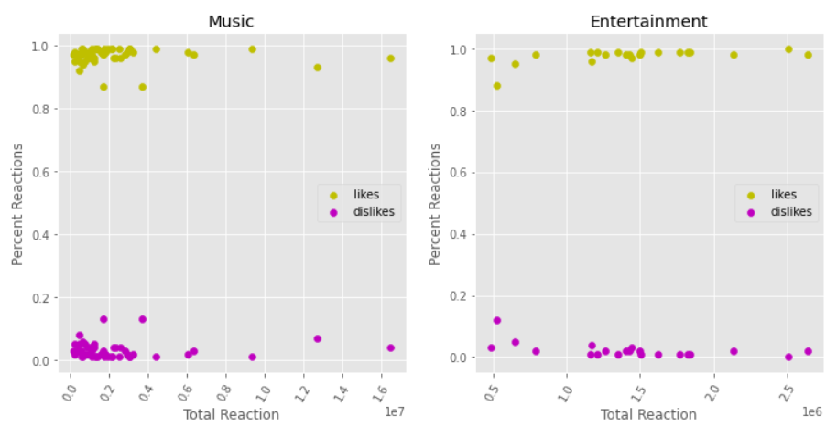
Comparison Between the Top Two Categories: Music vs. Entertainment Music and entertainment are the top two popular categories and have very similar reactions in regards to the number of likes and dislikes.

Slide 13
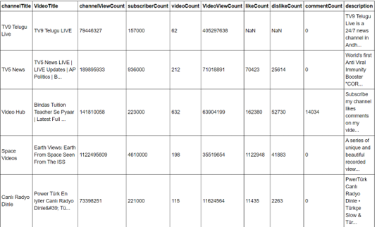
Most relevant Videos in 2019

Slide 14
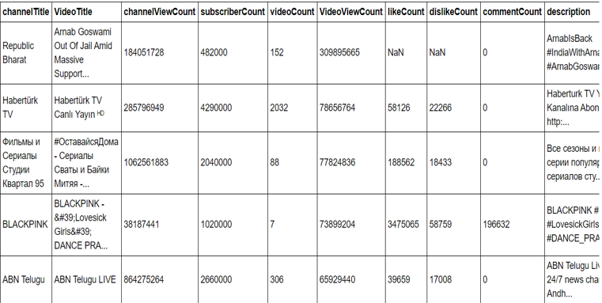
Most relevant Videos in 2020 The 2019- and 2020-word clouds contain key words from the most watched videos based on the comments. The most common words appear larger in the cloud.

Slide 15
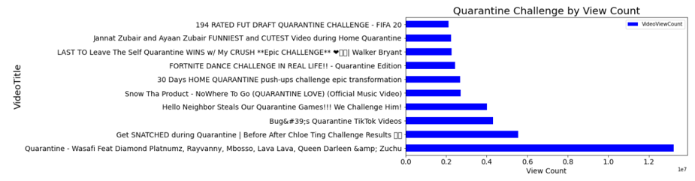
The Most Viewed Quarantine Challenge Videos During Strict COVID Lockdown The horizontal bar graph depict the most viewed quarantine challenge videos created during lockdown. This data was pulled from the YouTube Search API dataset and the word clouyd was generated from the comments.

Slide 16

Hypothesis 1

Slide 17
Actual Result: YouTube trends aligned with societal
YouTube trends aligned with societal events accordingly based on the Top Five Liked Videos dataframe and the most popular categories bar chart. Music was the most popular category during this time and this was reflected as the top five videos were all related to K-Pop music groups, BTS and Blackpink. According to the top trending channel bar charts, the most popular channels in each month fall into either the music or entertainment categories; these are the top two popular categories overall:
August: Big Hit Labels was the most popular channel as BTS dropped music teasers and a video for their song, Dynamite.
September: Blackpink was the most popular channel as Blackpink dropped a song with Selena Gomez called Ice Cream.
October: The Pixel Kingdom, a gaming channel, was the most popular channel as it reviewed the hit game Among Us.
November: JYB Entertainment is the most popular channel in November so far as another K-Pop Group, Twice, released new music.
Societal events will align with YouTube Trends (ex. Quarantine challenges/vlogs, new music video releases, video games etc.)

Slide 18
Hypothesis 2

Slide 19
Actual Result: YouTube trends aligned with societal
This hypothesis was proven false based on our analysis. According to our scatter plots, as view count increased, there was a decrease in reactions. The overall number of likes, dislikes, and comments gradually declined. It was also observed that when videos are recently published and have a lower number of views, there is a stronger number of likes compared to dislikes and comments. This suggests that users interact with videos with likes rather than actively leaving comments as it is easier. The scatter plots also displayed how the number of dislikes and comments remained consistant for the Entertainment and People & Blogs category. If we focus solely on the top two categories, Music and Entertainment, we see that the scatter plots are very similar with the relationship between view count and reactions. Although, it does suggest that the music category as a stronger % of dislikes and likes when there is a lower view count compared to the entertainment category.
If viewer count increases, viewer reactions will increase as well. This includes number of likes and dislikes as well as number of comments.

Slide 20
Hypothesis 3

Slide 21
Actual Result: YouTube trends aligned with societal
Based on the various data frames produced, the data suggests that YouTube viewing increased in 2020 compared to 2019. However, this maynot be an acurate mesurement as youtube videos published in 2019 can still be viewed today and will be counted towards their view value. This may be due to the stay-at-home orders issued across the world due to the COVID pandemic.The top five videos pulled from the YouTube API datasets in 2019 and 2020 were all largely international videos
In 2019, the top five videos:
Telegu News
TV5 News - Telegu News
Video Hub
Earth Views from Space
Turkish TV video
In 2020, the top videos:
Republic Bharat - Indian News
Haberturk TV - Turkish
Russian TV Show
Blackpink - Dance Practice
ABN Telegu News
During the strict COVID lockdown from March to June, there were no changes in viewer trends. Regardless of the pandemic, it seems that users continued to watch their typical videos, ranging from music to fitness, and entertainment. This is displayed from our YouTube API bar chart:
Diamond Platinumz - Quarantine (Tanzanian Artist)
Chloe Ting - Get Snatched During Quarantine
Quarantine Tik Tok Videos
Hello Neighbors Steals our Quarantine Games
SnowthaProducts- Nowhere to Go (Quarantine Love) (song created by a Mexican/American artist and rapper)
Compared to 2019, YouTube viewing will increase in 2020. The lockdown will not affect the viewer trends because trends will remain consistant regardless social circumstances.

Slide 22

THANK YOU

